Slide 1
L-J Model of Argon

Slide 2
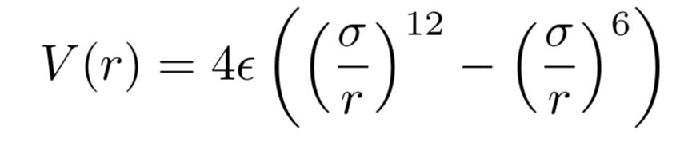
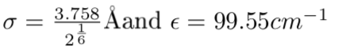
12-6 form of Lennard-Jones potential

Slide 3
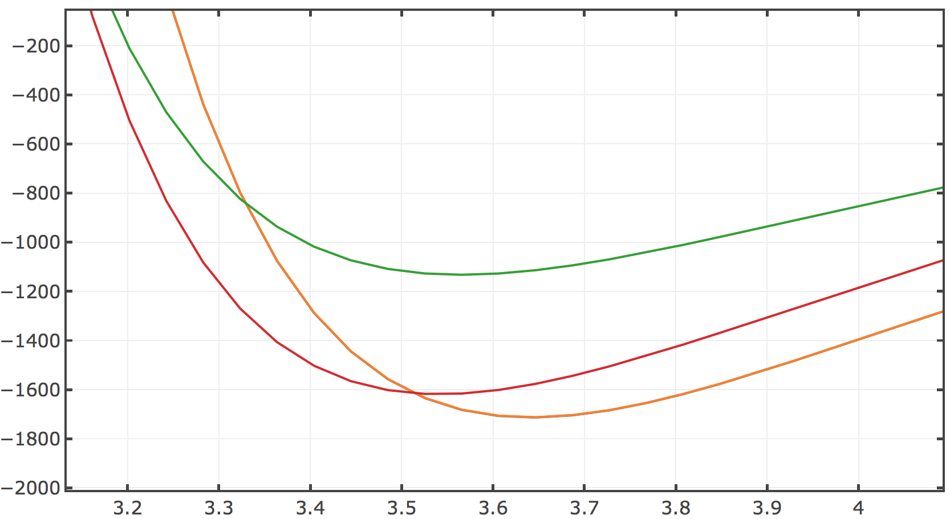
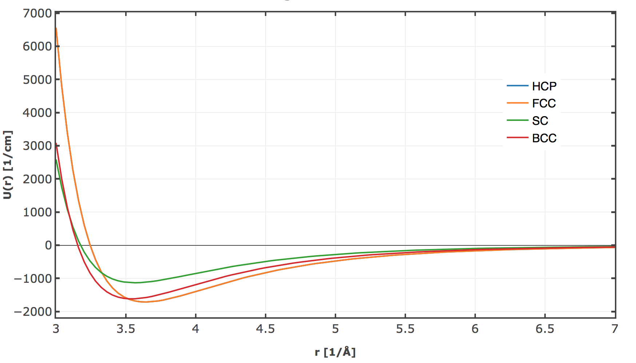
L-J Model

Slide 4

FCC or HCP?
 | Spacing Å | Energy cm⁻¹
SC | 3.56 | -1132.4812
BCC | 3.52 | -1617.4023
FCC | 3.64 | -1712.5192
HCP | 3.64 | -1713.2478
0.00042

Slide 5
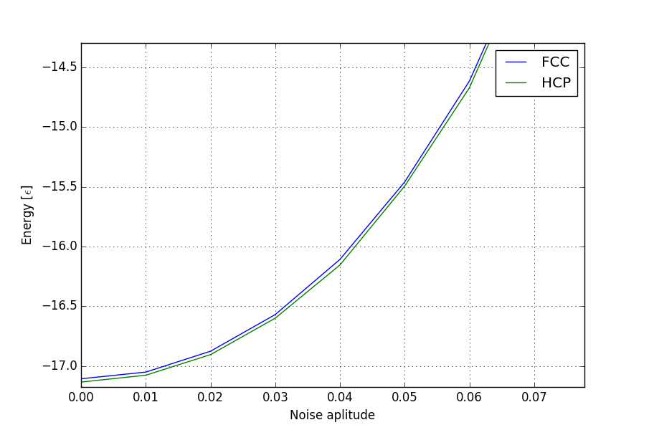
Adding Noice to the lattice

Slide 6
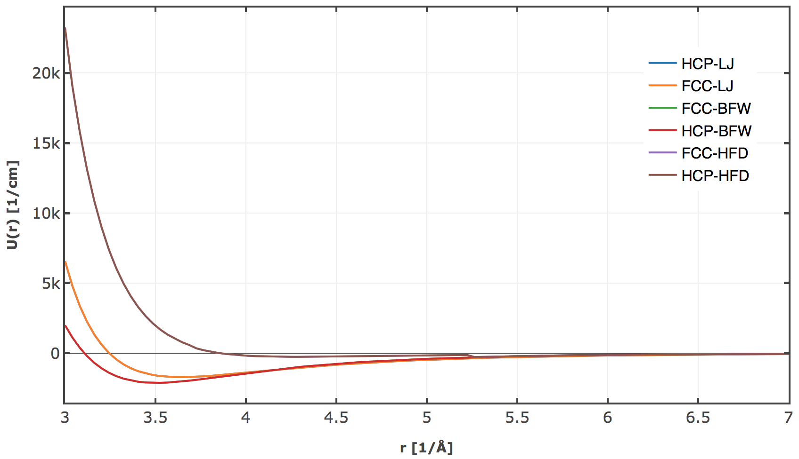

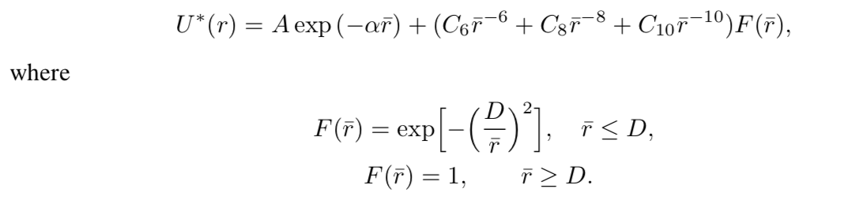
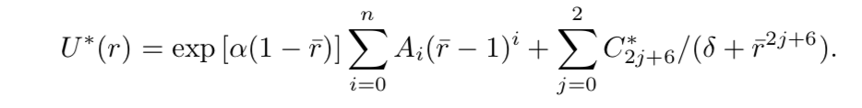
Using different potentials
HFD
BFW
0.00025

Slide 7
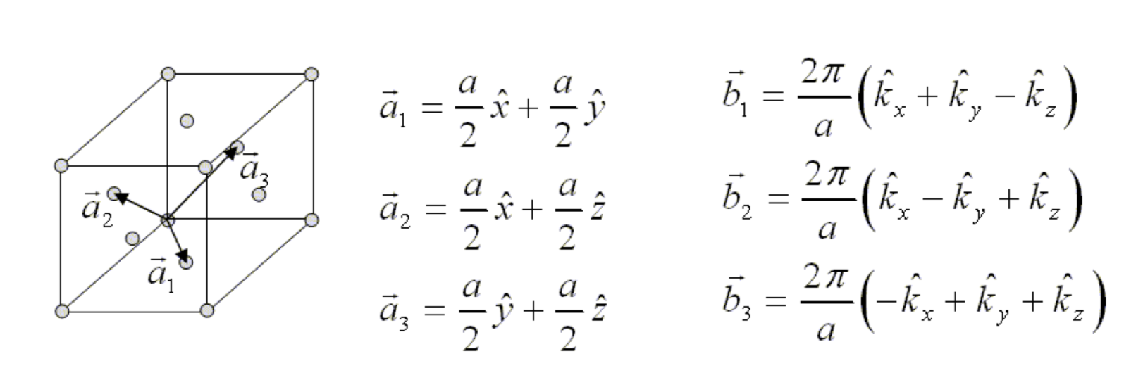
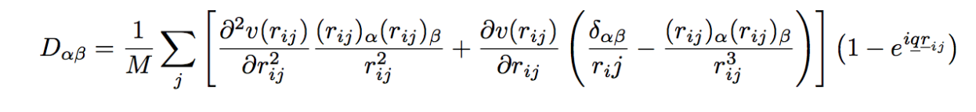
Phonon Dispersion
FCC

Slide 8
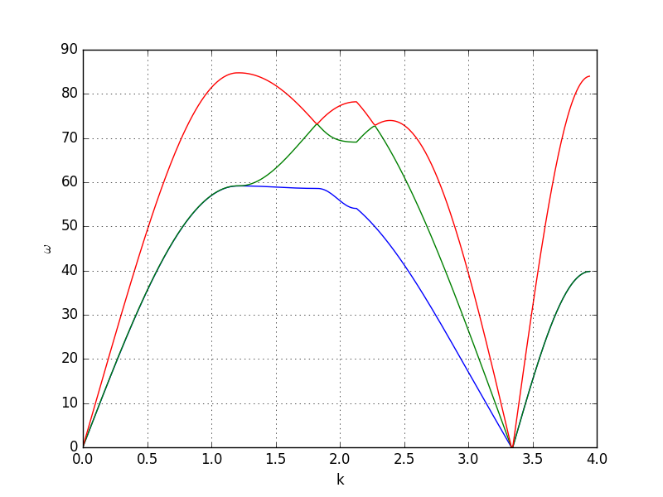
Phonon Dispersion
𝚪
X
W
K
𝚪
L

Slide 9
Phonon Dispersion
𝚪
X
W
K
𝚪
L
184
123

Slide 10
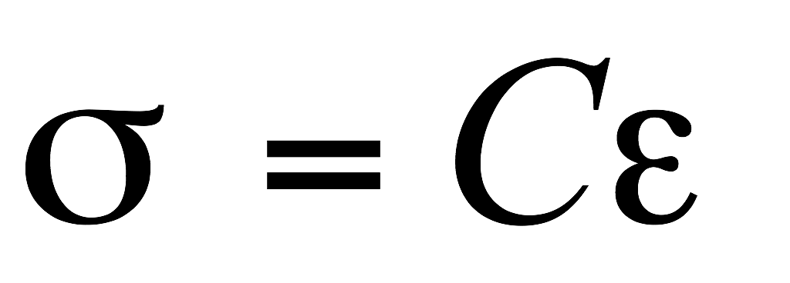
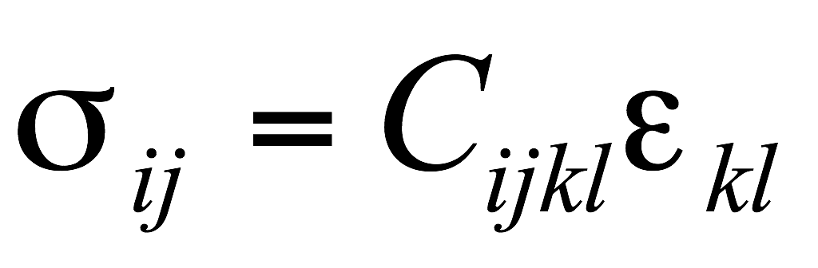
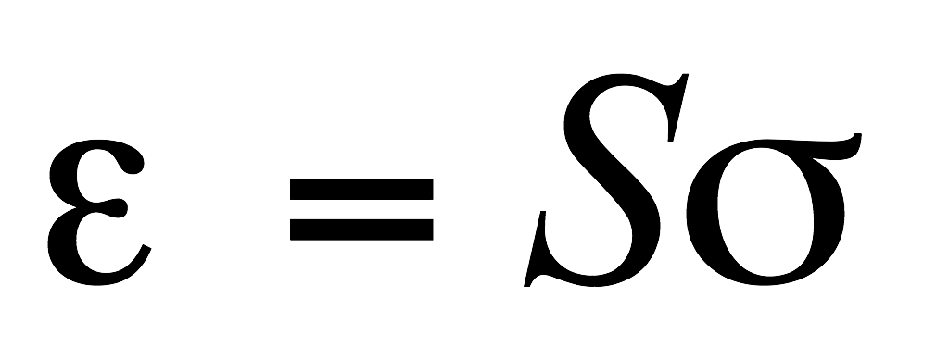
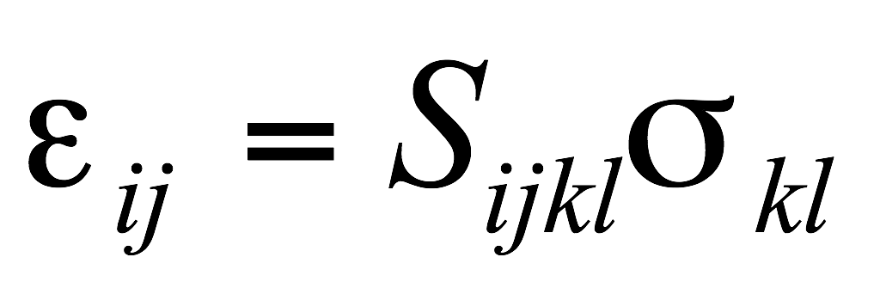
Sound Velocity
For small stress, strain is proportional (linearly varies with) strain ➢ Hooke’s law.
The proportionality constants are 4th order (rank) tensors.
Tensor form
Hooke’s law

Slide 11
Elastic Constants
The total number of expected components are: 2D: 2×2×2×2 = 16 3D: 3×3×3×3 = 81. But, not all of these are independent.
➢ Cijkl = Cijlk (also, Sijkl = Sijlk) ➢ Cijkl = Cjikl (also, Sijkl = Sjikl) ⇒ only 36 of the 81 components are independent (for even the most general crystal)*.
From energy arguments it can further be seen that: Cijkl = Cklij (also, Sijkl = Sklij)* ⇒ of the 36 components only 21 survive (even for the crystal of the lowest symmetry).
All cubic crystals (irrespective of their point group symmetry) have only 3 independent components
⇒ Cijkl (or Sijkl)→ these are C1111, C1122, C2323.
This is further reduced in the case of isotropic materials to 2 independent constants (C1111, C1122).
Usually, these independent constants are written as E & ν.
Hence, for second rank tensor properties (like magnetic susceptibility, χij) cubic crystals are isotropic,
but, not for forth rank tensor properties like Elastic Stiffness.

Slide 12
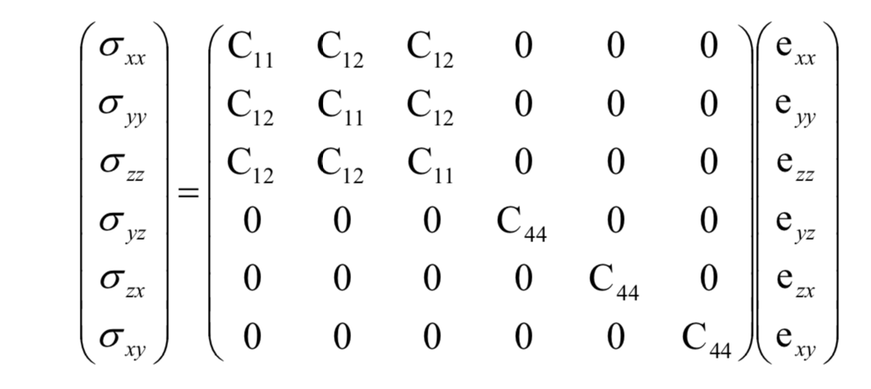
Elastic Constants

Slide 13
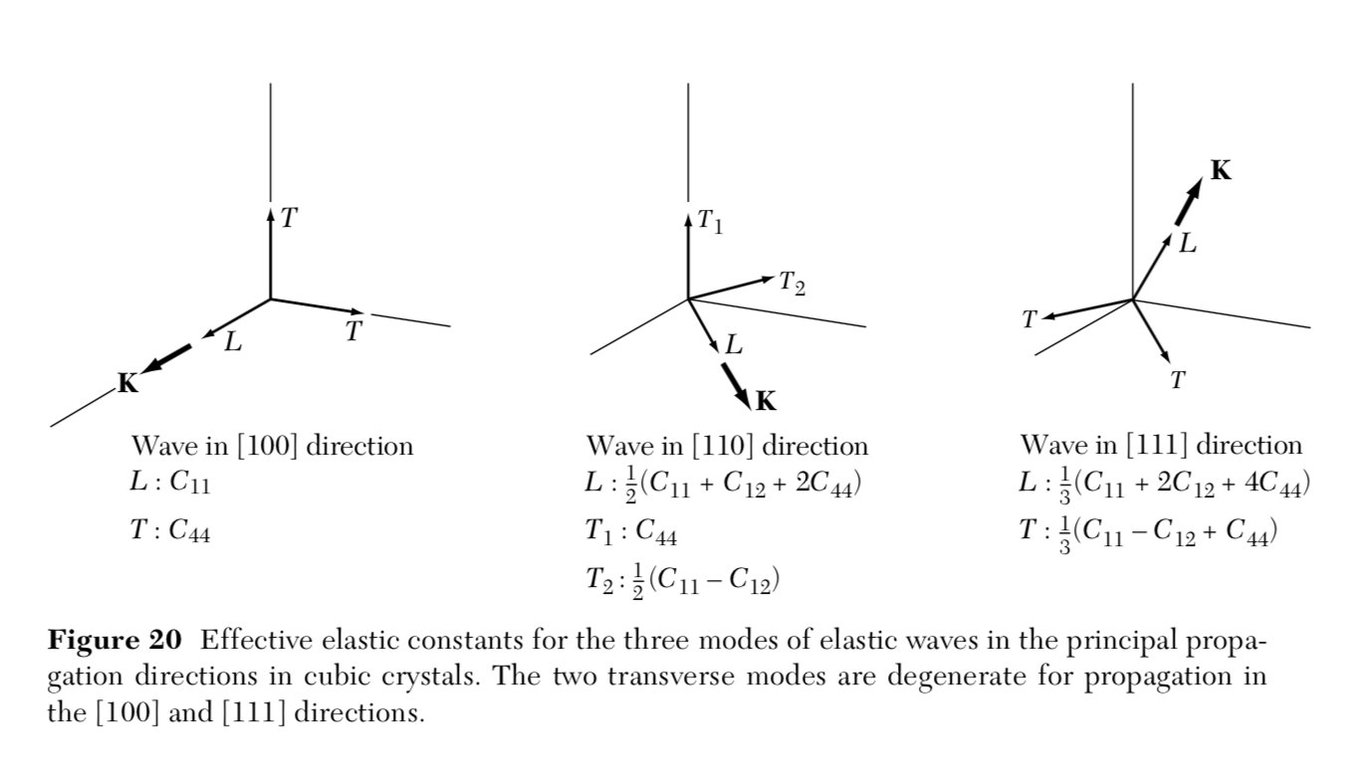
Velocities
velocity ⍵/k of a longitudinal wave in the [100] direction is vs = (C11/⍴)^{1/2}
velocity ⍵/k of a transverse wave in the [100] direction is vs = (C44/⍴)^{1/2}

Slide 14
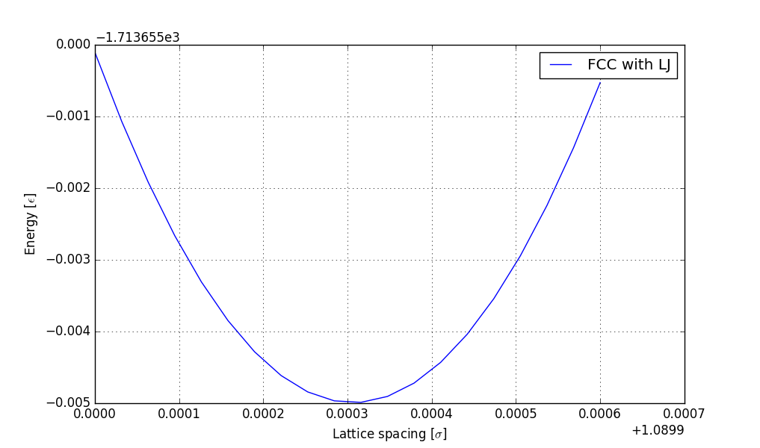
Sound Velocity :: TODO

